Slide 1
Connecting the Dots: One Man’s Story
Management Information Forum
January, 2013
David S. Hefner, CEO
Georgia Regents Medical Center
Georgia Regents Medical Associates
EVP for Clinical Affairs

Slide 2
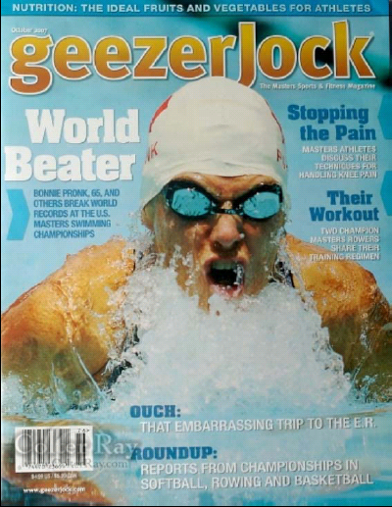

Vital Statistics
Age = 58
Married
2 Daughters; 4 grandchildren
Competitive swimmer

Slide 3

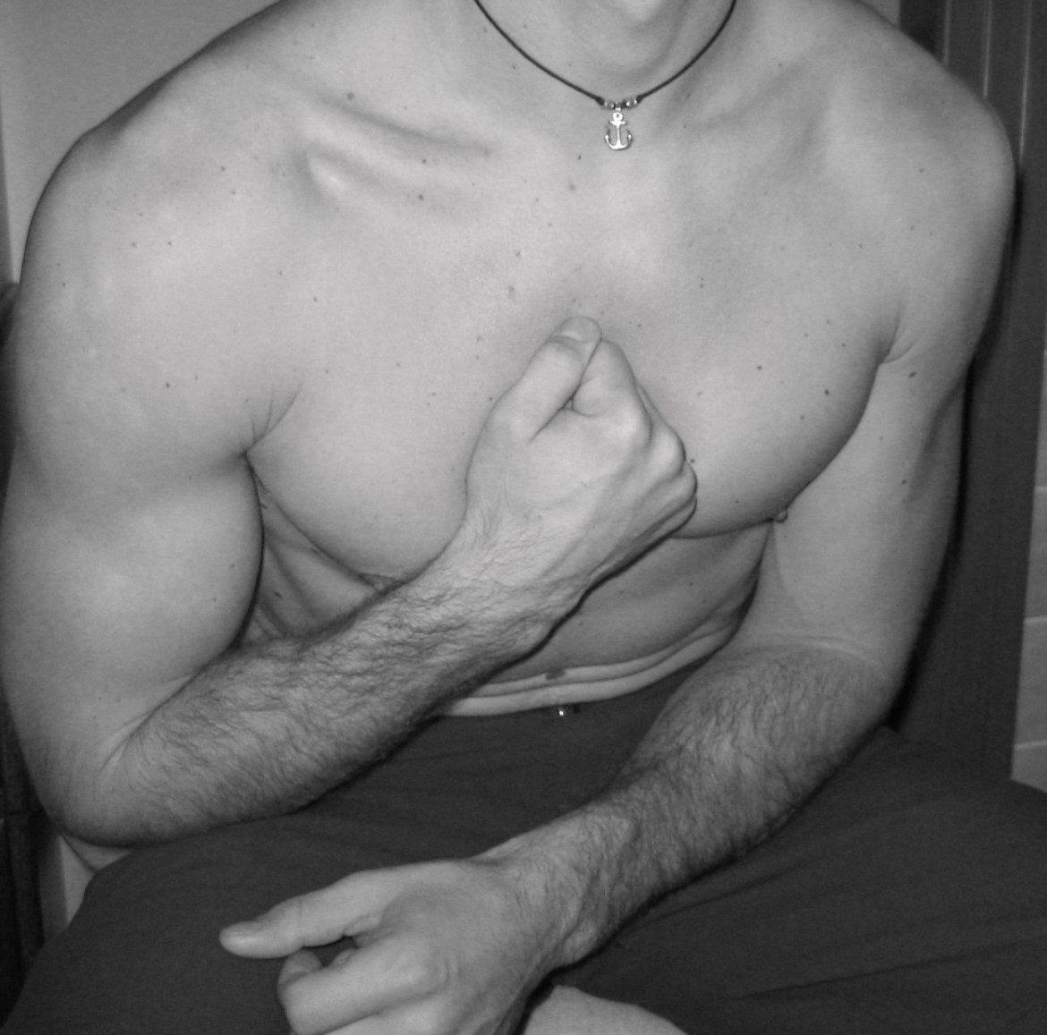
At age 47, on a Saturday morning…

Slide 4
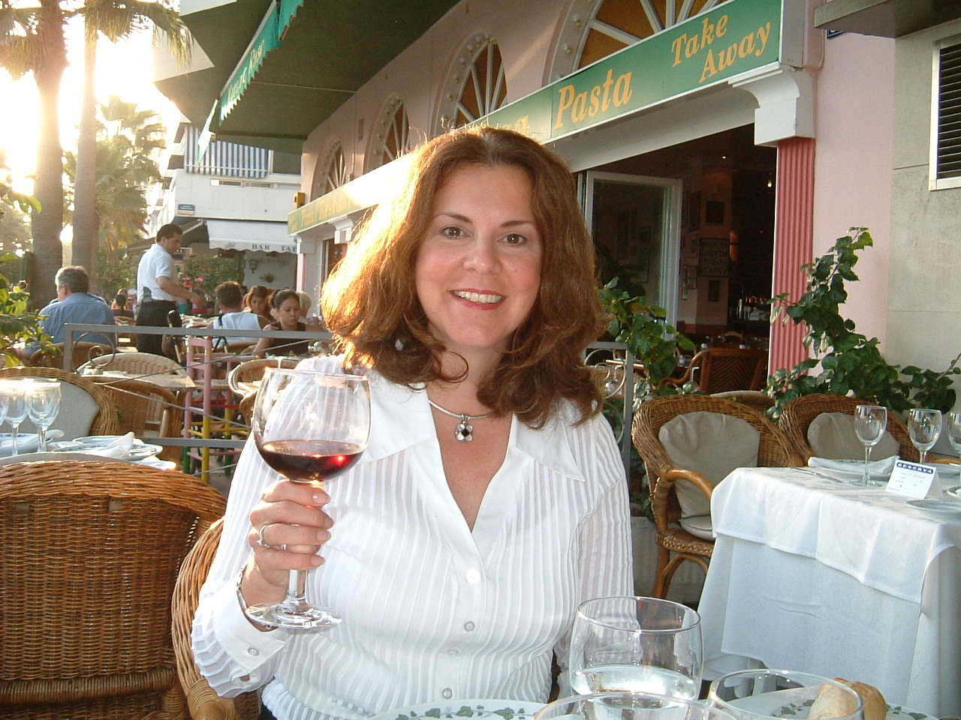
Note:
Heart-healthy red wine
911

Slide 5
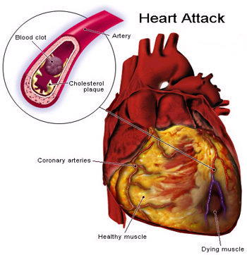

Heart Attack = Myocardial Infarction
Plaque accumulates
  chronic buildup of porridge-like fats-atherosclerosis
Plaque ruptures
  rapid formation of a thrombus or blood clot
Blood supply stops
Muscle dies

Slide 7
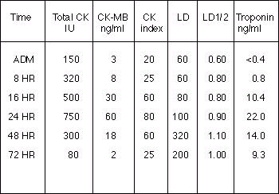
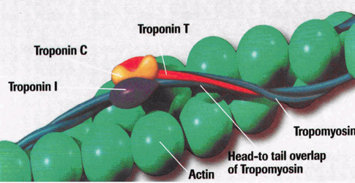
← Normal
← @ 16 hours, my level
was at 79

Slide 8
Ejection
Fraction What it Means
50 - 70% Normal
36 - 49% Below Normal
35 - 40% May confirm diagnosis of systolic heart failure
< 35% Patient may be at risk of life-threatening
irregular heartbeats
30% On the way to “sudden cardiac death”!

Slide 9
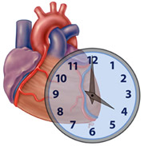
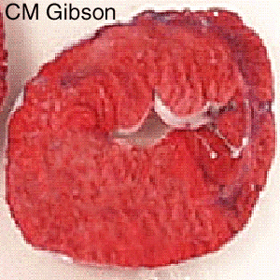
Myocardia Infarct Motto:
“Time is Muscle”

Slide 10
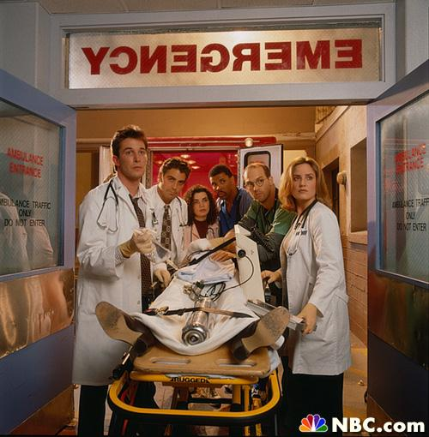


Slide 11
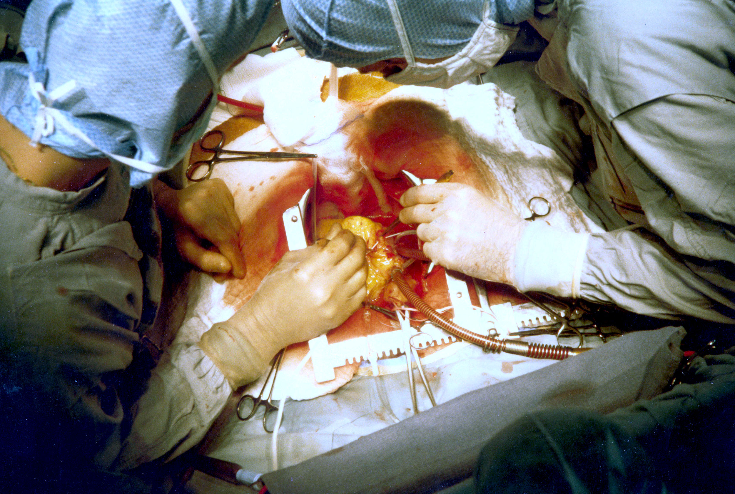
The Good Old Days: Limited Choices

Slide 12
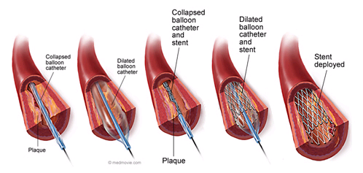
Today’s New Choices

Slide 13
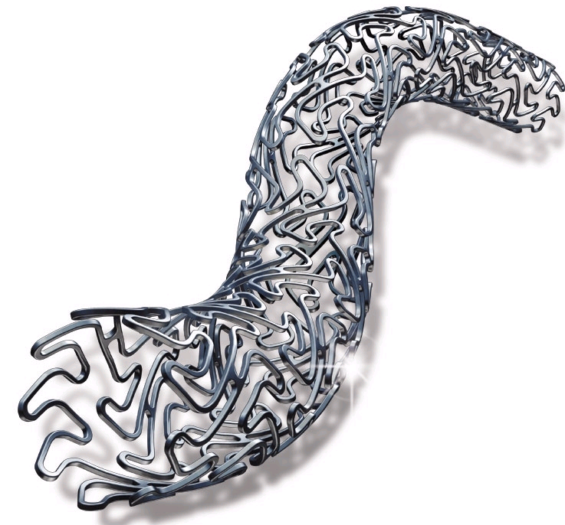
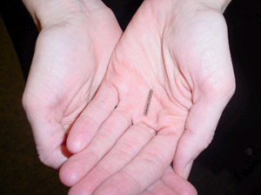

Slide 14
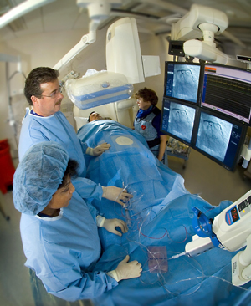
Real-Time Coronary Angiography

Slide 17

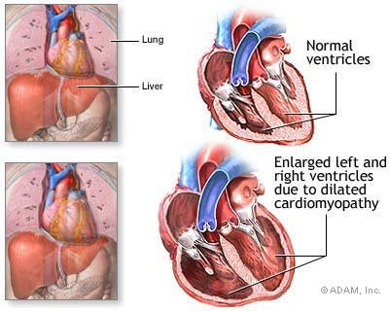
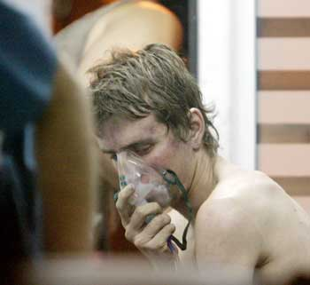
Preparing for Cardiomyopathy

Slide 18

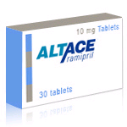

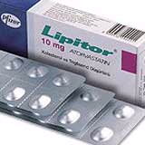

Post-MI Protocol (with a twist)
+
+
+
β-blockers slow heart,
decrease need for blood
ACE Inhibitors
lower blood pressure
+
Prevent clots in arteries
Statins lower cholesterol
Applied Research project to ward off Alzheimer's

Slide 19

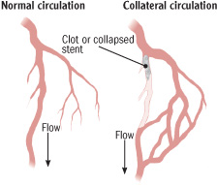
or

Slide 20
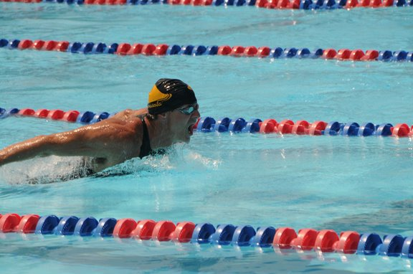
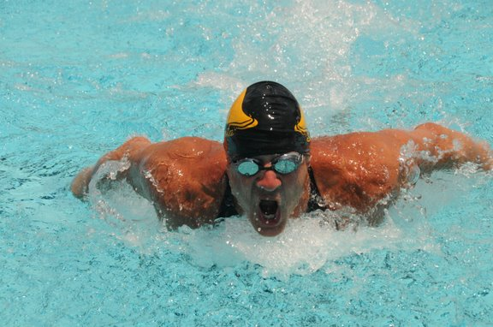

Slide 21

“Maybe in 10 years we will know why something like this happens to people like you”
Why is Research Key?

Slide 22
Bigger than Cancer…
Age-adjusted death rates for CHD, stroke, lung and breast for white and black females (United States: 2004). Source: NCHS and NHLBI.

Slide 23
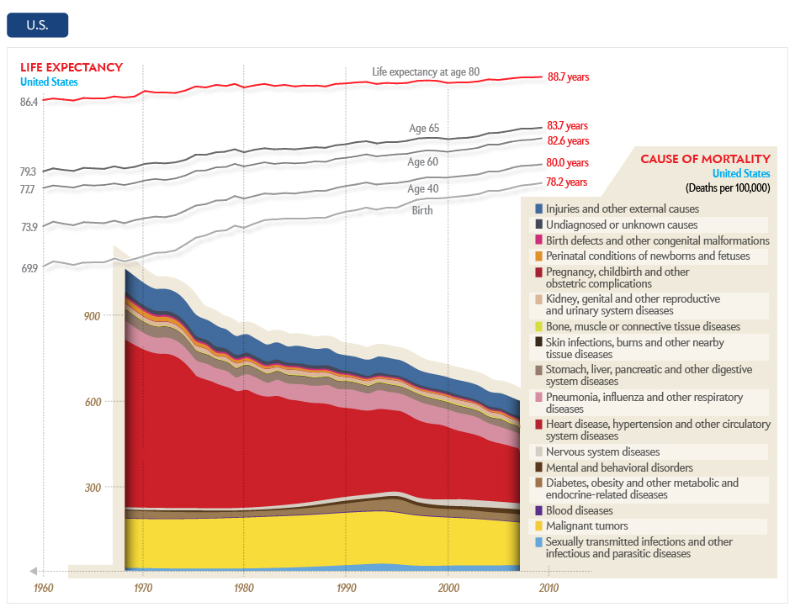
…And Having a Dramatic Impact

Slide 24
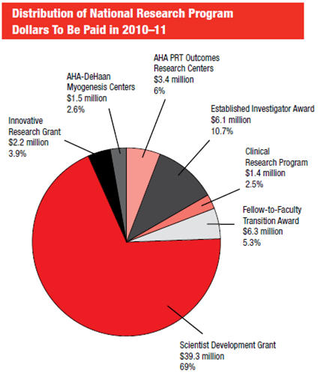
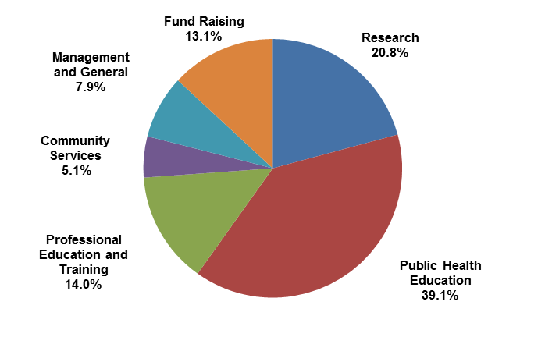

Slide 25
So What is the Moral of this Story?
Eat well…?
Exercise vigorously…?
Listen to your wife…?
Contribute to the American Heart Association?
The correct answer is “All of the Above”!

Slide 26
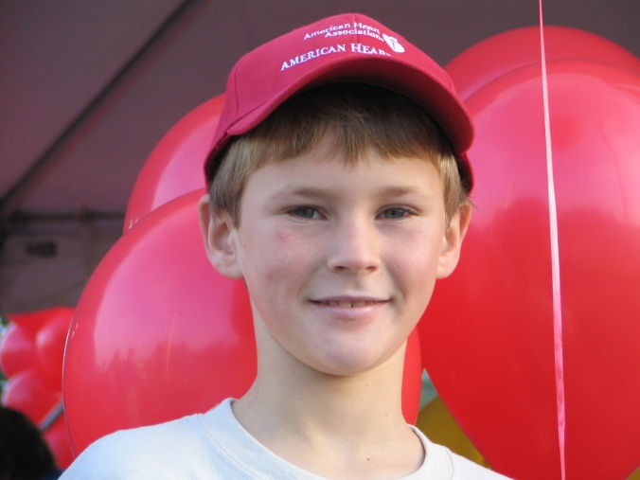
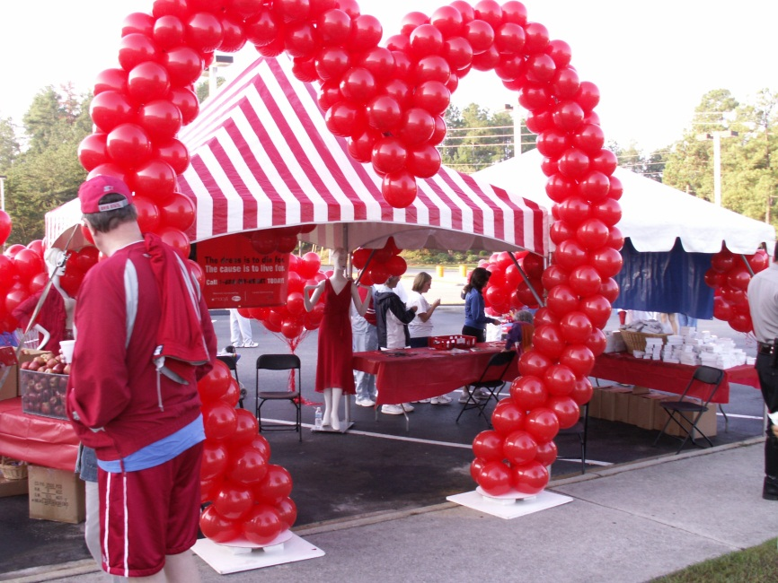

Updates: Coming Events
American Heart Association Heart Walk
We are top ten in the nation in AHA funding,
NUMBER ONE in the nation in funding per capita!
Help us beat
last year’s total
$117,000!!!
March 9, 2013
North Augusta Greeneway
Notes:
GRU is top ten in the nation in AHA funding, and NUMBER ONE in the nation in funding per capita!
Last year, we hoped to raise $50,000. Having exceeded that number weeks before the scheduled date, we stretched the goal to $75,000.
We raised $116,911.88 MORE THAN DOUBLE our original goal!!! Let’s see how high we can raise the bar this year!

Slide 27
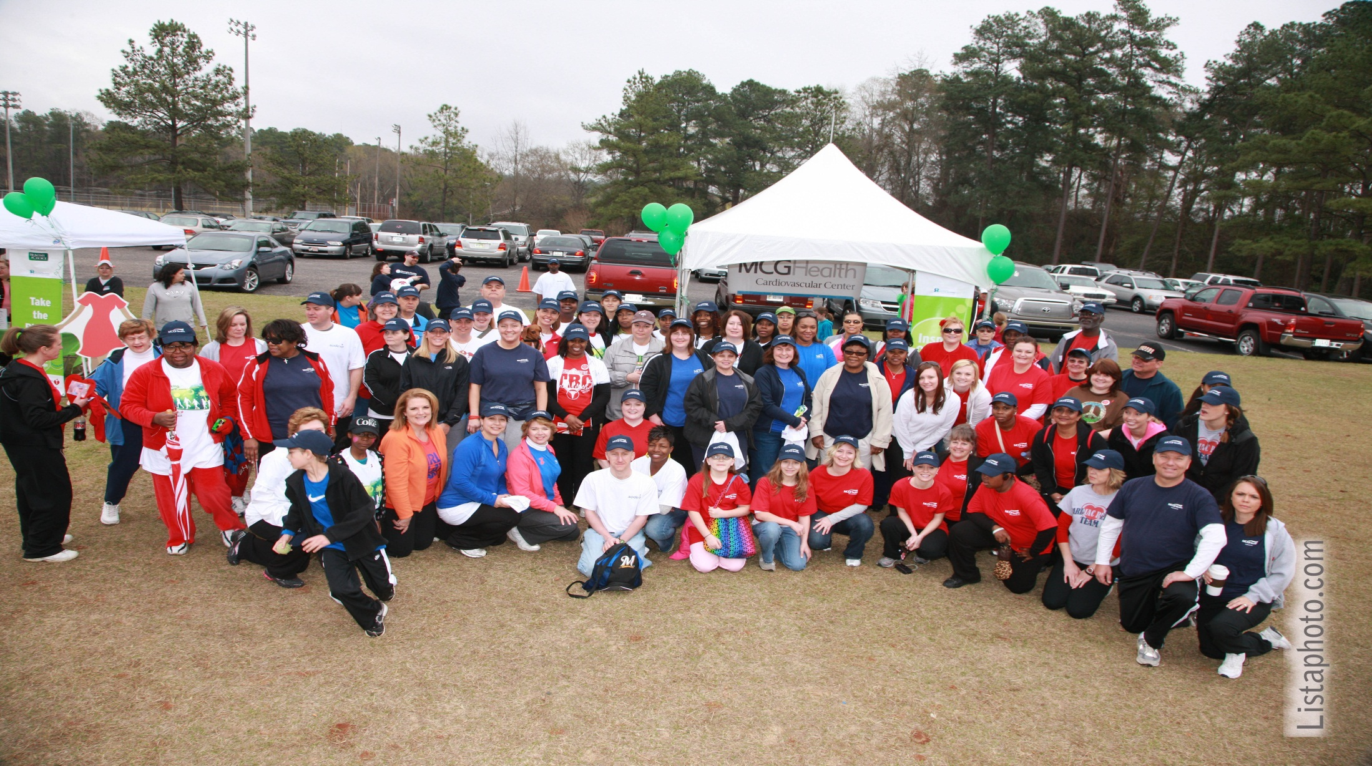
Our 2010 Heart Walk Team

Slide 28
Looking Forward to Seeing You There

