Slide 1
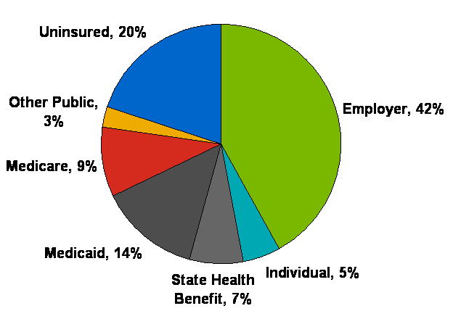
Georgia Profile
Total State Population: 9.7 million
Medicaid Enrollment (2011): 1.7 million total
% population below poverty: 24%
% population uninsured: 20%
Total Spending Under Medicaid (2010): $7.2B
  Federal Share: $5.4B (or 75%)
  State Share: $1.8B (or 25%)
Health Coverage & Uninsured in Georgia (2010)
(1.9M)
(250K)
(4M)
(914K)
(1.3M)
(479K)
(700K)
Data Point: in Georgia, 57% of births and 72% of long term care services are paid for by Medicaid.
Non-Enhanced FMAP Rate is Approximately 65/35
Sources: CMS, Kaiser Family Foundation, National Governor’s Association

Slide 2
Average Medicaid Payment Per Recipient for All Services FY2008
Medicaid Costs in Georgia are Low:
Comparison Against 16 Southern Legislative Conference States
Source: Southern Legislative Council “Comparative Data Report on Medicaid,” March 15, 2011

Slide 3
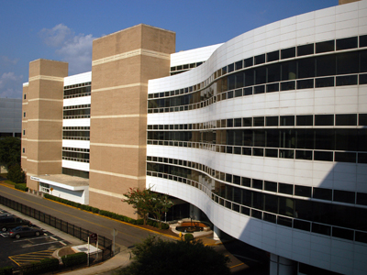
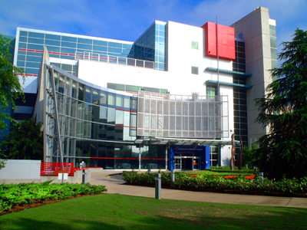

Georgia Health Sciences Health System Vitals
476 bed adult hospital ; Level 1 Trauma
154 bed children’s hospital; Level 1 Trauma
20,000 admissions
450,000 outpatient and ED visits
495 Full-time faculty
155 Part-time faculty
1,230 Clinical/adjunct appointments
$100M practice plan
19 Clinical Departments
11 Centers, Institutes & Service Lines
$175M Corrections care for 50,000 inmates

Slide 4
FY2012 Payor Mix
Notes:
Over 50% from government sources, which is under pressure from various directions; over 30% Medicaid and Self pay; Medicaid attributed largely to CMC

Slide 5
Health System Support to University vs. Other Sources
} $33M
} $30M
} $19M
Notes:
Health System support has been growing as State support has been under considerable pressure

Slide 6
Health System Charity Care Support
at Cost
Notes:
Health System provision of charity care (at costs) has more than doubled in last five years.

Slide 7
What Do We Want As Consumers of Healthcare?
BETTER
FASTER
CHEAPER
LESS EXPENSIVE
ACROSS ALL OF PATIENT CARE…..
ELIMINATE OR REDUCE …….
WASTE, DUPLICATION, INEFFICIENCES, & UNNECESSARY VARIATIONS

Slide 8
Said Another Way….
Better,
Faster,
Less Expensive
What We Do
+
Where We Do It
+
How We Do It
= f
,therefore…
…we must redesign what we do, where we do it, and how we do it, to produce a “better, faster, less expensive” result!
(or said another way, we must have
top decile performance on all measures)

Slide 9
How Do We Strengthen Our Relevance for 4M Citizens?
(Advanced & Complex Care)
*
Predictive, Preventative, Diagnostic & Chronic Care
General Acute Care
Tertiary (migrating to community hospitals)
Quaternary (domain of AHCs)
Post-Acute/
End of Life
Coordination and Transition Management
Educate primary care physicians & health professionals
Transportable care delivery models that are preventative, predictive, and personalized
Interprofessional care team education/training models
Public Health linkages & create interventions for social determinants of health; meaningful health services research
Regionally
non-duplicative, distinctive,
multi-mission programs
Partner with community to delivery primary & first level 2˚ are on lower cost delivery chassis
Organize faculty and staff to reflect this orientation
Partner with community to delivery post-acute care
Partner with patients and families on palliative care & hospice options
*
Inclusive of mental & behavioral health
Notes:
9

Slide 10
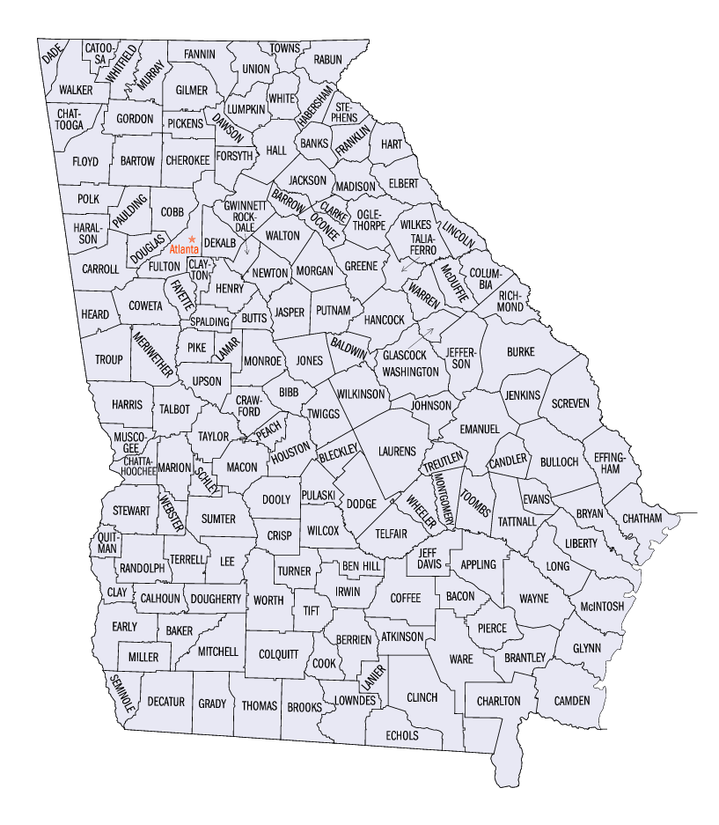

Board structure
  Children’s hospitals service areas:
  Board structure that adheres to these principles:
  26 member Board
    6 Primary Care (one from each region)
    6 Specialist (one from each region)
    6 Hospital/Large Group (one from each region)
    6 At Large
    Kathryn Cheek (Georgia AAP Immediate Past President)
    Bob Wiskind (Georgia AAP President)
1
Greater GA
2
Atlanta
3
Augusta
4
Macon
5
Columbus
6
Savannah
1
Greater GA
Notes:
Atlanta’s region includes the primary service area only, the ATL MSA.
Augusta’s region is an approximate primary service area.
Columbus’s region includes West Central (7) and Southwest (8-2) Public Health Districts
Macon’s region includes primary and secondary service areas
Savannah’s region includes primary and secondary service areas

Slide 11
Support for
Graduate Medical Education
Notes:
Georgia has historically provided significant contribution to the training of residents within Medical Center. Continuation of this support is vital to the Health System’s missions – on all fronts.

