Slide 1
Harvesting the Power and Potential of Academic Health Enterprise Alignment & Integration: Case Study Reflections on Approaches and Results
g
MCG Health System
Annual Board Retreat
August 17, 2010
David S. Hefner
Senior Advisor, Healthcare Innovation
Association of American Medical Colleges
202/828-0491
dhefner@aamc.org
(Please Note: This presentation does not
represent an endorsement by the AAMC)

Slide 2
Opening Thoughts
My intent is to build upon what has been said and bring it down in altitude
How to move from the theoretical to the to the practical or do-able?
Extend the thinking and language from hospital/clinic/physician to other schools, missions, faculty (“Academic Health Enterprise, AHE, AHC)
Presentation crafted with a subset of your interdisciplinary colleagues yesterday
Invite you to listen to these themes as occurring in parallel
Think from the perspective of:
  $1B multi-mission enterprise
  10,000 faculty and staff (and 2000+ students & xxxxxx patients )
The opportunity you have is to transform Academic Medicine & MCG on behalf of:
  The 12,000?
  Augusta’s 500,000?
  Georgia’s 10M?
  Best practice, leading edge example for the Nation?

Slide 3

Watershed Moments?

Slide 4
Today’s Agenda
Context Setting
Funds Flow, “All Funds, All Missions” Integrated Budgeting, & Accountability Mechanisms
Managing in a Complex Matrix Environment
Embedding Talent Management & Leadership Development
Effectively Managing the Transition Process
Breakthrough Sustainable Results
The Board’s Role
Questions, Clarifications, Discussion

Slide 5
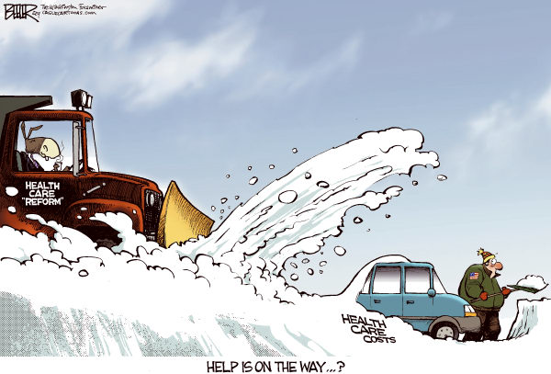
A Word About "Health Reform" Implications

Slide 6
A Word About "Health Reform" Implications
↑ Access = ↑ Demand + continued perverse incentives = ↑ ↑ Costs (which will burden margins & potentially stress the ability to cross-subsidize)
↑ Demand + ↑ ↑ Costs = ↓ Value = ↑ Upset
↑ consolidation of health plans, hospitals
↑ consolidation of physicians in larger medical groups and employed vehicles
SGR fix and CBO (re)calculations add another $400B to the $1T increased spend
NIH funding likely to be → (or possibly ↓)
GME funding likely to ↓ ($30B at-risk over 10 years through MedPac or IPAB)

Slide 7



A Word About "Health Reform" Implications
We have a wholly unsustainable “system”
Universal Coverage + Financing ≠ Reform
Pre-occupation with the Revenue Curve
Real reform lays under the Cost Curve by eliminating the waste, duplication, redundancies, inefficiencies, unnecessary variations [redeploy $650B of $2T spend]
Health Innovation Zone (HIZ) language for MCG to pursue

Slide 8
Chartis’ Strategic Alignment Framework
Aligned Mission / Vision
Strategic
Mechanisms to align and coordinate strategies across school, hospital, and practice plans
Management
Governance
Governance and management structures to align boards and subcommittees around collective objectives
Process and structures to align organizations around goals and performance
Alignment / Performance
Economic
Methodologies to share / align economics to support strategy and performance
Trusting / Productive Relationships

Slide 9
Mission Congruity
Spectrum of Mission Overlap
Medical School Education
Not a Shared Mission
Moderate Overlap
Shared
Mission
Graduate Medical Education
Not a Shared Mission
Moderate Overlap
Shared
Mission
Basic Science Research
Not a Shared Mission
Shared
Mission
Moderate Overlap
Clinical Research
Not a Shared Mission
Shared
Mission
Moderate Overlap
Patient
Care
Not a Shared Mission
Shared
Mission
Moderate Overlap
Community Service
Not a Shared Mission
Shared
Mission
Moderate Overlap

Slide 10
Leadership Working Relationships
Frequency and Depth of Collaboration
Collaborate on Key Decisions
Infrequent
Often
All of Most of the Time
Fully Share Operational and Financial Information
Infrequent
Often
All of Most of the Time
Recognize the value and interdependence of success across entities and missions
Infrequent
Often
All of Most of the Time
Willing to compromise for the greater good
Infrequent
Often
All of Most of the Time
Trust each other
Infrequent
Often
All of Most of the Time

Slide 11
Articulating a Powerful Visions
ILLUSTRATIVE
Potential Strategic Objectives Which Unify Academic and Clinical Capabilities:
“Nationally recognized for its team-based approach to health care delivery, education and research”
“Recognized internationally for interdisciplinary programs that bridge all elements of MCG and MCGHS”
“Unique in its participatory approach to managing the AHC and the extensive involvement of its faculty and staff in improving performance”
“Achieve significant health status improvements locally and statewide by using MCG’s capabilities to study and address health disparities and other factors”
“Achieve a uniquely successful learning experience by understanding each student’s learning approach and using MCG’s resources to deliver the most effective approach”
“Establish a regional system of care that delivers superior outcomes and service to the area’s residents”

Slide 12
Today’s Agenda
Context Setting
Funds Flow, “All Funds, All Missions” Integrated Budgeting, & Accountability Mechanisms
Managing in a Complex Matrix Environment
Embedding Talent Management & Leadership Development
Effectively Managing the Transition Process
Breakthrough Sustainable Results
The Board’s Role
Questions, Clarifications, Discussion

Slide 13
Academic Health Enterprise Funds Flow By Key Sources¹
(FYxx Budget²)
Bonds, loans:
$17M
GME:$68.2M
Other Income:
$17.4M
Patients/ Other Payers: $624K
Gifts
$750K
ILLUSTRATIVE
T&A $17.8M
Prch. MD. Srvs $18.5M
Faculty Compensation
MD Admin $4.9M
Admn Srvs $1.2M
Hospital
MD Comnts $4.5M
Salaries/Fringe/Other
$150M
PCPs $15.6M
Rent $3.7M
Staff
Compensation
Parking $1.6M
Salaries/Fringe/Other $23M
Lsed Emplys $2.3M
Health System
Dept Shortfalls $860K
Faculty Practice
Plan (FPP)
MD Support $115K
Shortfall Support $860K
ARC $575K
Departments
Affiliate Svcs $400K
FPP Support $3.8M
Overhead $350K
$7.4M
Billing Expenses
Net Patient
Revenues
Net Revenues $112.1M
Clinical Billings
Rent (non-hospital) $580K
Malpractice $4.2M
Other
Prof. Development $2.2M
Research
Research $18.5M
Pass-Through $14.8M
Spcl. Purpose $1.3M
$1.2M
Network
Schools of
Medicine & Allied Health
Indirects:
$43.5M
Interest/
Endowment:
$17.7M
¹ Bad debt is not deducted.
² To protect client confidentiality, all numbers have been adjusted to disguise actual performance.

Slide 14
Managing from an “All Funds, All Missions”
Integrated Budget Perspective
Articulate Strategic Priorities & Required Margin
With Finance Team Input, Reformulate Budgets as needed
Total Margin = Required Margin?
Finance Team Sets New Targets
NO
YES
Chairs, PPG, MCGHI CEO, Provost, Present Budgets to Finance Team
Manage & Oversee Budgets
Agree on High Level Department Margins
Monthly Variance?
Support Colleague via “Peer Accountability Mechanisms”
Chairs:
Review Vice Chair & faculty performance
Articulate new expectations
Link to Departmental Comp & Incentive plans
Develop new budgets & business plans
Provost &
MCGHI CEO:
Review Chairs, VPs, Vice Deans, performance
Articulate new expectations
Link to Comp & Incentive plans
Negative
Positive
Acknowledge, Appreciate, Celebrate, Reward
ILLUSTRATIVE

Slide 15
Aligning Strategic Priorities and Goals
Quality
Education
Research
Sustainability
Community
ILLUSTRATIVE
New Metrics
Productivity
Pass Rates
Margins
Quality
Population
Engagement &
Effectiveness
CE awards
etc.

Slide 16
Today’s Agenda
Context Setting
Funds Flow, “All Funds, All Missions” Integrated Budgeting, & Accountability Mechanisms
Managing in a Complex Matrix Environment
Embedding Talent Management & Leadership Development
Effectively Managing the Transition Process
Breakthrough Sustainable Results
The Board’s Role
Questions, Clarifications, Discussion

Slide 17
Functional Integration in the Emerging Matrix and Team-Based Environment
Structures
Hospitals/
Depts
Clinics
PPG
Schools/
Depts
Education
Research
Functions
VP
Facilities
Facilities & Space
Finance
Quality
Development/Institutional Advancement
Information Systems/Information Technology/BioInformatics
Human Resources/Talent Management
Legal
Strategic Planning
Compliance; Risk; Audit; COI; Pt. Safety; Accreditation
Government Relations; Advocacy
Communications; PR; Marketing
Strategic Affiliations; Network Development
Supply Chain; Procurement; Purchasing
CSO
CCO
VP
Bus. Dev.
CFO
CQO
CDO
CIO/
CMIO
CHRO
CLO
CIO
CAO
VP
Supply
Chain

Slide 18
Effective Management in the Emerging Matrix and Team-Based Environment

Slide 19
Today’s Agenda
Context Setting
Funds Flow, “All Funds, All Missions” Integrated Budgeting, & Accountability Mechanisms
Managing in a Complex Matrix Environment
Embedding Talent Management & Leadership Development
Effectively Managing the Transition Process
Breakthrough Sustainable Results
The Board’s Role
Questions, Clarifications, Discussion

Slide 20
Organizational Change Requires Leaders

Slide 21
Talent Management & Leadership Development

Slide 22
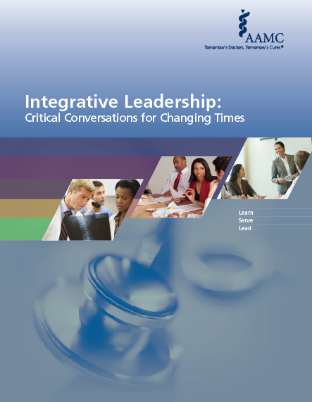

Slide 23
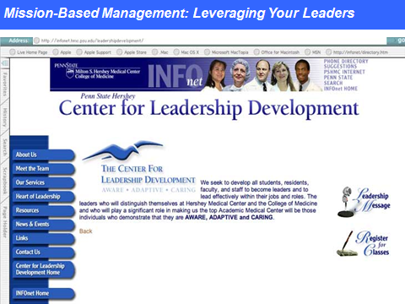
Investing in Your Future Leaders

Slide 25
Today’s Agenda
Context Setting
Funds Flow, “All Funds, All Missions” Integrated Budgeting, & Accountability Mechanisms
Managing in a Complex Matrix Environment
Embedding Talent Management & Leadership Development
Effectively Managing the Transition Process
Breakthrough Sustainable Results
The Board’s Role
Questions, Clarifications, Discussion

Slide 26
Effectively Managing the Transition Process
State
Change
Effort Units
Result
Units
FORMULATION 100 in : 1 out
CONCENTRATION 10 in : 1 out
MOMENTUM 1 in : 1 out
BREAKTHROUGH 1 in : 20 out
MASTERY 1 in : 100 out

Slide 27
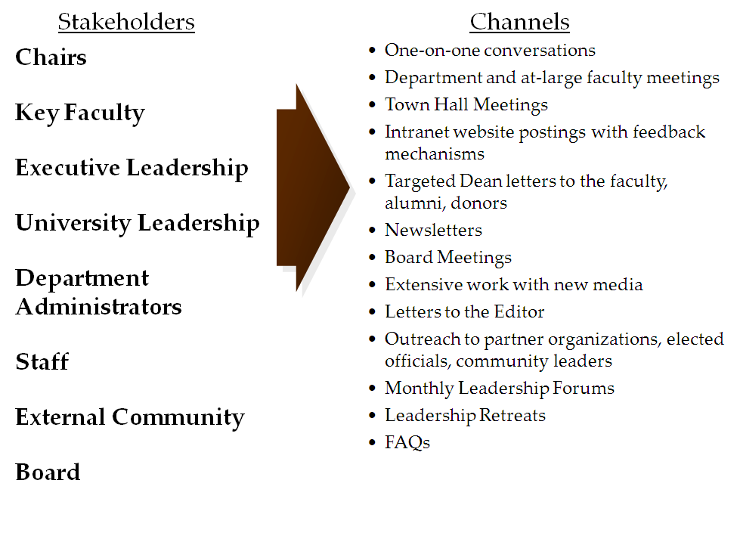
Effectively Managing the Transition Process

Slide 28
Sustaining Change with Technology Solutions…
Finance/GL;
Human Resources;
Materials Management

Slide 29
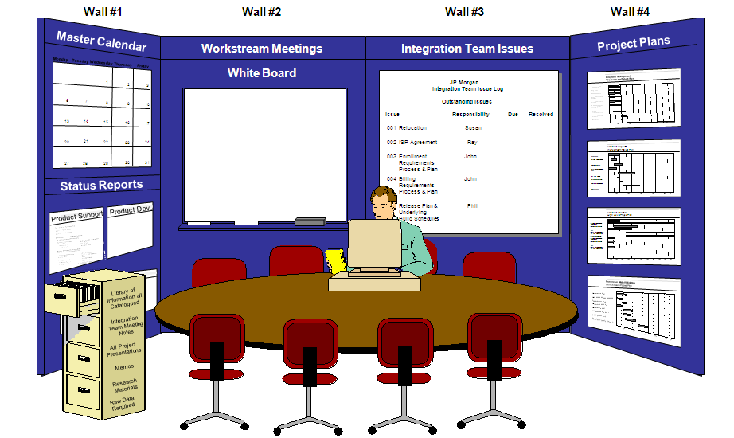
Effectively Managing the Transition Process

Slide 30
Today’s Agenda
Context Setting
Funds Flow, “All Funds, All Missions” Integrated Budgeting, & Accountability Mechanisms
Managing in a Complex Matrix Environment
Embedding Talent Management & Leadership Development
Effectively Managing the Transition Process
Breakthrough Sustainable Results
The Board’s Role
Questions, Clarifications, Discussion

Slide 31
Breakthrough Sustainable Results

Slide 32
Breakthrough Sustainable Results

Slide 33
Breakthrough Sustainable Results

Slide 34
Today’s Agenda
Context Setting
Funds Flow, “All Funds, All Missions” Integrated Budgeting, & Accountability Mechanisms
Managing in a Complex Matrix Environment
Embedding Talent Management & Leadership Development
Effectively Managing the Transition Process
Breakthrough Sustainable Results
The Board’s Role
Questions, Clarifications, Discussion

Slide 35
The Board’s Work in Leading Transitions

Slide 36
“Never doubt that a small group of thoughtful, committed people can make a difference.
Indeed, it is the only thing that
ever has.”
— Margaret Mead
Notes:
Lead line

Slide 37
Today’s Agenda
Context Setting
Funds Flow, “All Funds, All Missions” Integrated Budgeting, & Accountability Mechanisms
Managing in a Complex Matrix Environment
Embedding Talent Management & Leadership Development
Effectively Managing the Transition Process
Breakthrough Sustainable Results
The Board’s Role
Questions, Clarifications, Discussion

